Slide 1

Software Engineering and Project Management
Research Journal
Design Proposal
Bacteria Scanner integrated in Smart Watches
Submitted To:
Shelly Garg
Submitted By:
Ujjwal Kumar Gupta (500091584)
Nishant Rastogi (500090864)

Slide 2
Purpose
Coughing, sneezing, and a running nose are the most common symptoms of a cold in humans. As humans, we occasionally forget to sanitise our hands, allowing bacteria to be more effective on our skin and blood.
While meeting friends with the gesture of a handshake, we share our bacteria with other ones also, and this chain goes on .Mobile healthcare based on wearable biosensors has drawn a lot of public interest as technology and healthcare have grown in popularity.

Slide 3
The healthcare system is undergoing a critical transformation from the traditional hospital-centered system to an individual-centered system as a result of the growing population, ageing, and chronic vital diseases that are continuously driving up healthcare costs. Optical biosensors have been the main focus of recent development, along with improvements in wearable technology.
Due to advancements in structural and material innovations, wearable systems are now able to measure both biophysical and biochemical indicators conformably, accurately, and continuously, which is a necessary step given the daily increase in unhygienic conditions. This upgrade is required to meet the demands of reminding ourselves to sanitise and maintain cleanliness.

Slide 4
Problem Statement
The people can receive the proper clinical assistance at the appropriate time if they have access to portable scanners that can be used to check for bacterial or viral pathogens that may cause any health issues or simply to ensure the rate of pathogens.
Incorporating biosensors into smart watches to find viruses and bacteria. This research journal primarily focuses on the integration of biosensors into smart watches for the purpose of identifying bacteria that may cause health issues.

Slide 5
Solution
This research journal contains the integration of biosensors into smart watches. In which the dial of the smart watch will be detachable and the user can use that watch dial to scan the portion of the skin to measure the bacterial presence.
In the coming years, wearable biosensors will be the way of the future because they will revolutionise healthcare and give users quick feedback on a variety of biological indicators, giving them the opportunity to act quickly to control the situation.

Slide 6
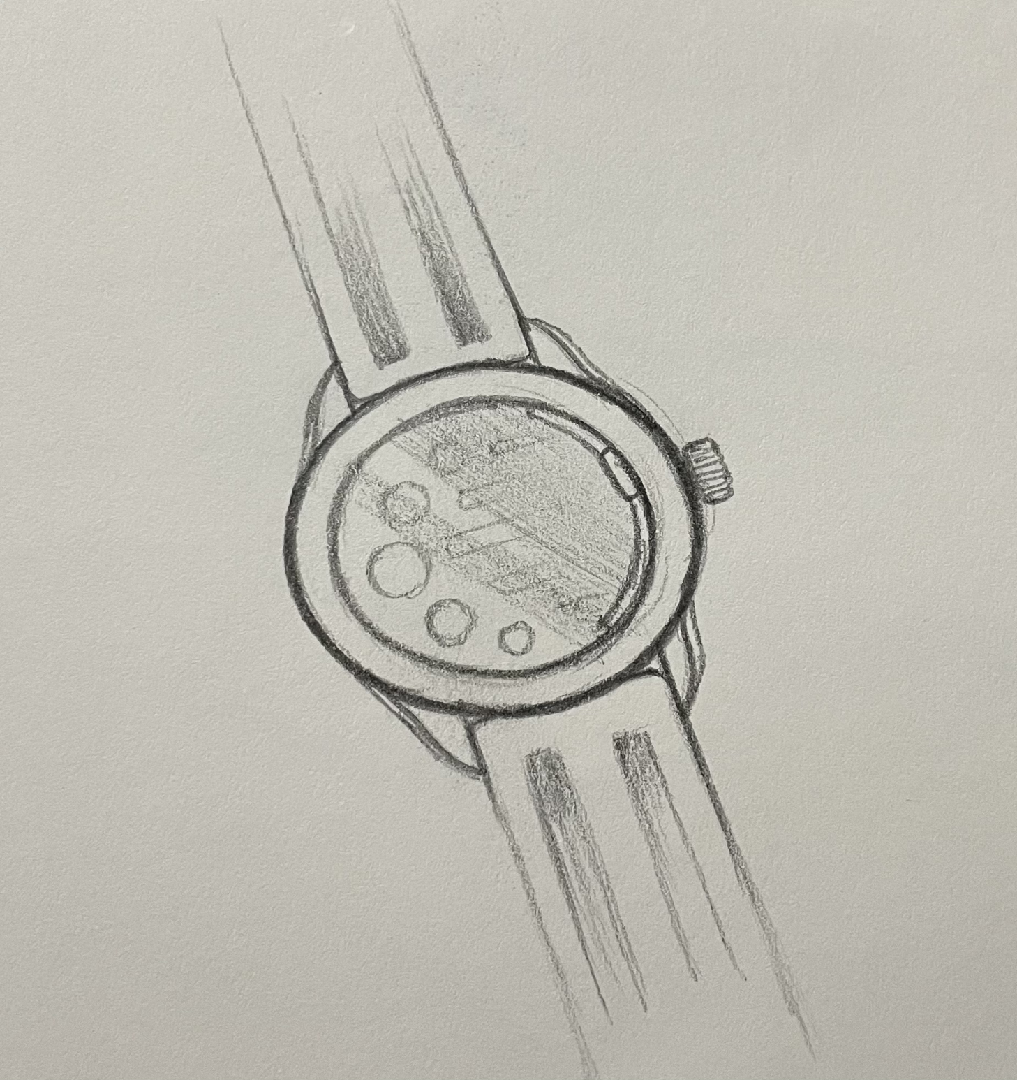
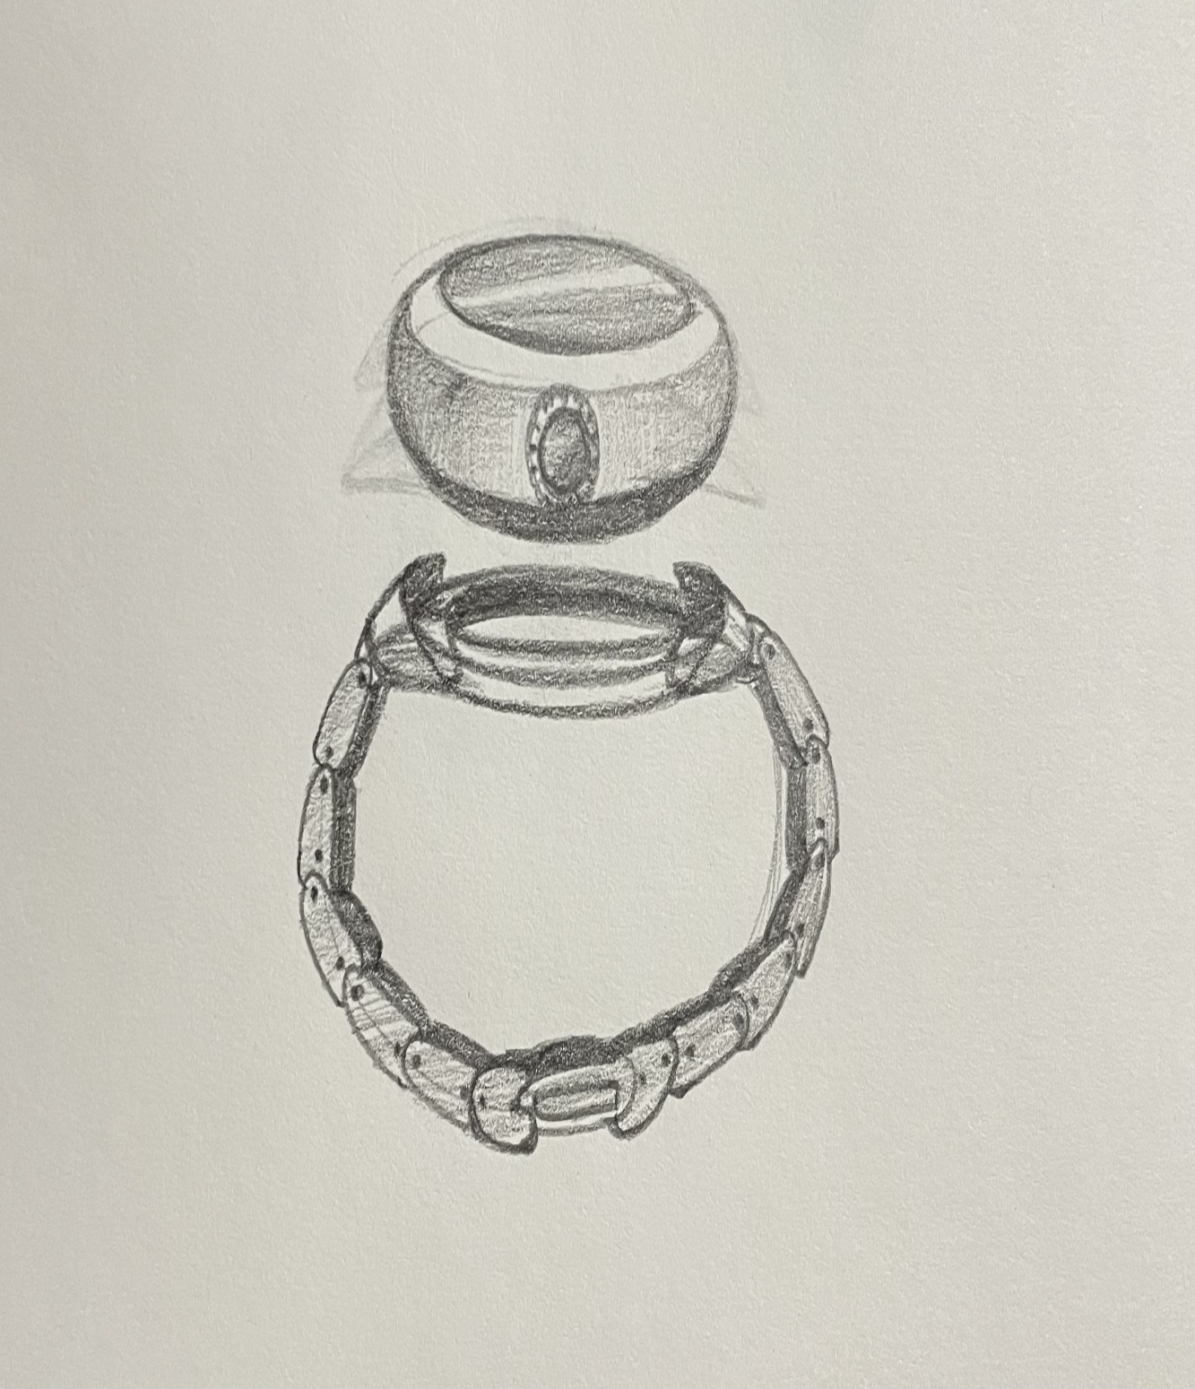

Slide 7
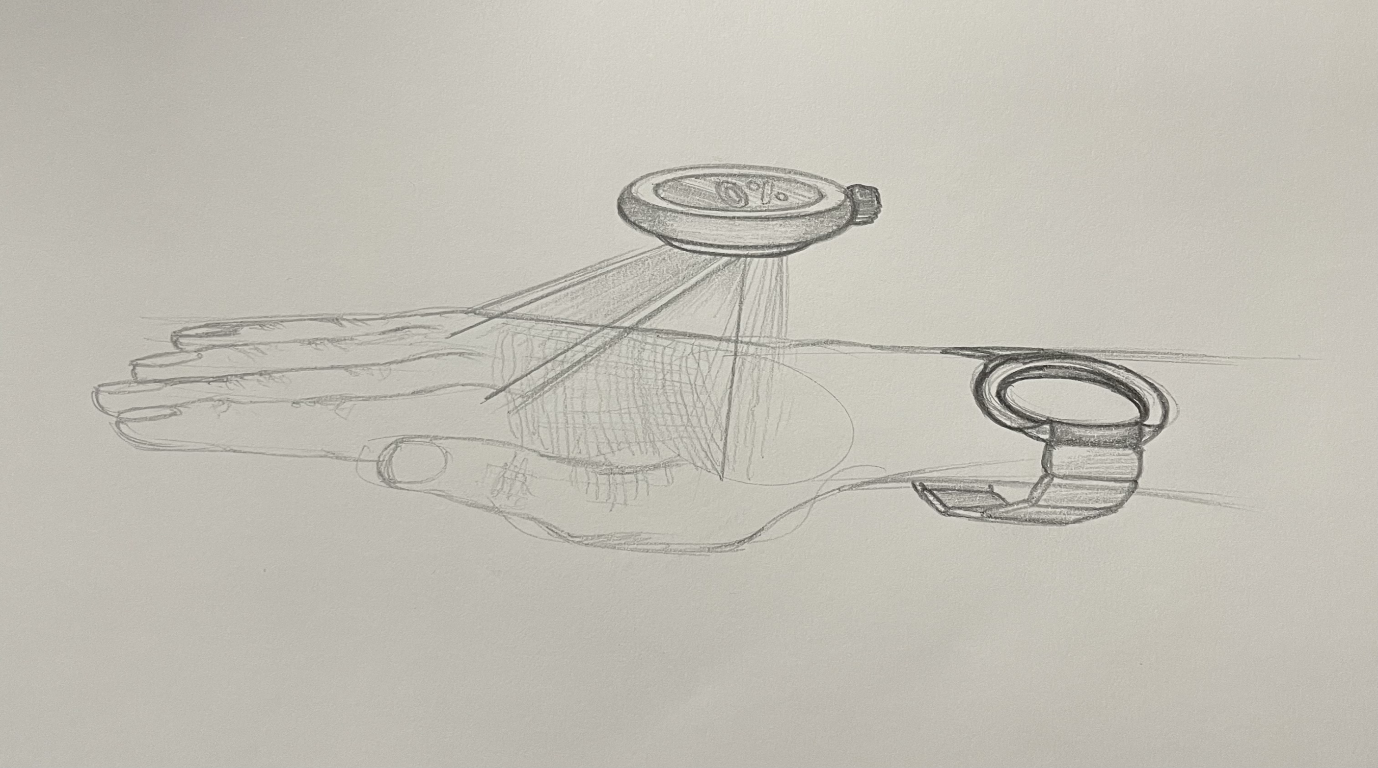

Slide 8
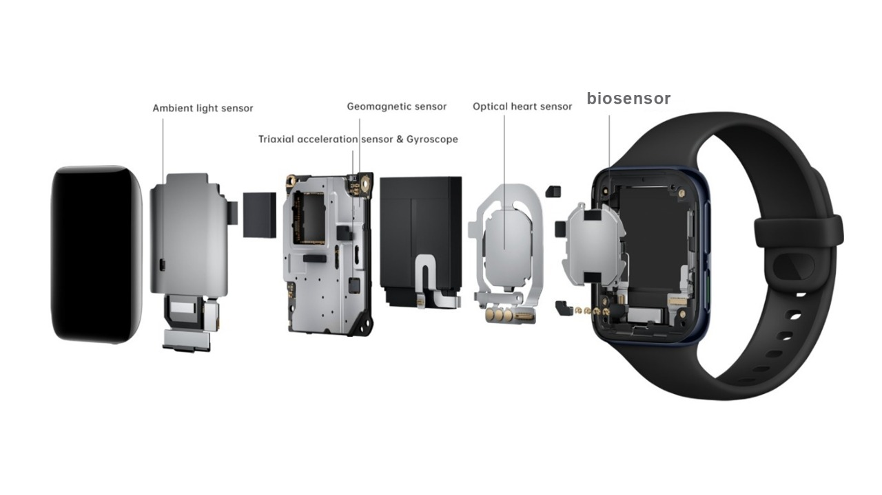
Credits:wearablestouse/blog

Slide 9
Innovation
We are incorporating the bio-sensor into wearable technologies with the aid of our research. These wearables show promise and are capable of a higher understanding .Wearable devices have evolved gradually with a mix of multiplexed biosensing.
These biosensors can be used to create additional innovations by being incorporated into other wearables like bracelets, tattoos, and clothing. Self-powered wearable biosensors are one such innovation, but the discussion also includes other aspects of health, such as physiological indicators like body motion, temperature, and vital signs.

